Slide 1
System modeling

Slide 3
Limitations of the Human Brain
Traditional practices unfortunately support the use of thousands of “system shall“ requirements
These requirements are typically generated via interviews and working sessions with business stakeholders.
It is nearly impossible to read the thousands of requirements and emerge confident that the requirements are complete.
Analysts who use traditional practices to create software requirements experience common problems during analysis, organization, and consumption of the requirements.
Traditional practices use long lists of text requirements in the form of shall statements or, more recently, user stories and product backlogs.
The challenge of working with long lists of items results from a fundamental limitation of human cognition.
Miller magic number
In the 1950s, cognitive psychologist George A. Miller found that humans can only remember and process seven plus or minus two items simultaneously

Slide 4
Pictures Are Easy, Words Are Hard
Where is elevator??
“From here you are going to go out to the right, then follow the path to the left, pass the bar, pass the slots, at the fountain go right, you’ll go past a restaurant, and another, then you will reach a hall where you can turn left by some shops, and at the end of that you’ll find elevators near the pool entrance.”

Slide 5
Pictures Are Easy, Words Are Hard
A picture is worth a thousand words
Models are visual representations (pictures) of information related to the processes, data, and interactions within and surrounding the solution being developed.

Slide 6
System modeling
System modeling is the process of developing abstract models of a system, with each model presenting a different view or perspective of that system.
System modeling represents a system using some kind of graphical notation, which is now almost always based on notations in the Unified Modeling Language (UML).
System modelling helps the analyst to understand the functionality of the system and they are used for communication with customers.

Slide 7
Existing and planned system models
Models of the existing system are used during requirements engineering. They help clarify what the existing system does and can be used as a basis for discussing its strengths and weaknesses. These then lead to requirements for the new system.
Models of the new system are used during requirements engineering to help explain the proposed requirements to other system stakeholders. Engineers use these models to discuss design proposals and to document the system for implementation.
In a model-driven engineering process, it is possible to generate a complete or partial system implementation from the system model.

Slide 8
Uses of graphical models
As a means of facilitating discussion about an existing or proposed system
Incomplete and incorrect models are OK as their role is to support discussion.
As a way of documenting an existing system
Models should be an accurate representation of the system but need not be complete.
As a detailed system description that can be used to generate a system implementation
Models have to be both correct and complete.

Slide 9
Types of System perspectives
An external perspective, where you model the context or environment of the system.
An interaction perspective, where you model the interactions between a system and its environment, or between the components of a system.
A structural perspective, where you model the organization of a system or the structure of the data that is processed by the system.
A behavioral perspective, where you model the dynamic behavior of the system and how it responds to events.

Slide 10
Context models
Context models are used to illustrate the operational context of a system - they show what lies outside the system boundaries.
At an early stage in the specification of a system, you should decide on the system boundaries
This involves working with system stakeholders to decide what functionality should be included in the system and what is provided by the system’s environment.

Slide 11
Context model for E-restaurant
Credit/debit card authentication
Customer
Order meal
Update menu
Restaurant
Manager
Pay for meal
Restaurant
operator
Deliver meal

Slide 12
System boundaries
System boundaries are established to define what is inside and what is outside the system.
They show other systems that are used or depend on the system being developed.
The position of the system boundary has a profound effect on the system requirements.

Slide 13
UML diagram types
UML has become a standard modelling language
Use case diagrams, which show the interactions between a system and its environment.
Sequence diagrams, which show interactions between actors and the system and between system components.
Class diagrams, which show the object classes in the system and the associations between these classes.
State diagrams, which show how the system reacts to internal and external events.
Activity diagrams, which show the activities involved in a process or in data processing .

Slide 14
Interaction models
All systems involve interaction of some kind. This can be
user interaction, which involves user inputs and outputs,
interaction between the system being developed and other systems or
interaction between the components of the system.
Modeling user interaction is important as it helps to identify user requirements.
Modeling system-to-system interaction highlights the communication problems that may arise.
Modeling component interaction helps us understand if a proposed system structure is likely to deliver the required system performance and dependability.
Use case diagrams and sequence diagrams may be used for interaction modelling.

Slide 15
Use case modeling
Use cases were developed originally to support requirements elicitation and now incorporated into the UML.
Each use case represents a discrete task that involves external interaction with a system.
Actors in a use case may be people or other systems.
A use case is shown as an ellipse with the actors involved in the use case represented as stick figures
Represented diagrammatically to provide an overview of the use case and in a more detailed textual form.

Slide 16
Online Shopping System use cases example
The Online Shopping system facilitates the customer to view the products, inquire about the product details, and product availability. It allows the customer to get register in order to purchase products. The customer can search products by browsing different product categories or by entering search keywords. Customer can place order and pay online. There are two acceptable payment methods. These are (1) pay by credit card and (2) pay by PayPal.
The system provide service to seller to place the products for selling. The seller creates account to become the member and places his products under suitable product category.
The systems allows the administrator to manage the products. It facilitates the administrator to modify the existing products categories or to add new products categories.
The system facilitate site manager to view different reports including (1) order placed by customers, (2) products added by sellers, and (3) accounts created by users.

Slide 17
Online Shopping System Stakeholders and associated use cases
Customer
view the products
inquire about the product details
inquire about products availability
get register
purchase products
search products
by category
by keyword
pay online
pay by credit card
pay by paypal

Slide 18
Online Shopping System Stakeholders and associated use cases
Seller
place the products for selling
create account
place products product category
Administrator
Manage products
modify the existing products categories
add new products categories
Site manager
view order placed by customers
view products added by sellers,
view accounts created by users.

Slide 19
Transfer-data use case
A use case in the MHC-PMS

Slide 20
Tabular description of the ‘Transfer data’ use-case
MHC-PMS: Transfer data
Actors | Medical receptionist, patient records system (PRS)
Description | A receptionist may transfer data from the MHC-PMS to a general patient record database that is maintained by a health authority. The information transferred may either be updated personal information (address, phone number, etc.) or a summary of the patient’s diagnosis and treatment.
Data | Patient’s personal information, treatment summary
Stimulus | User command issued by medical receptionist
Response | Confirmation that PRS has been updated
Comments | The receptionist must have appropriate security permissions to access the patient information and the PRS.

Slide 21
Use cases in the MHC-PMS involving the role ‘Medical Receptionist’

Slide 22
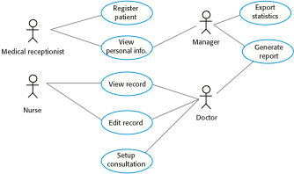
Use cases for the MHC-PMS

Slide 23
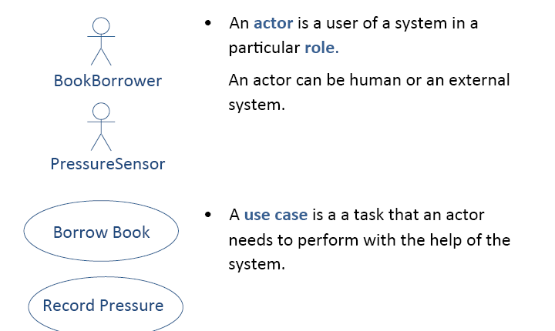
Actor and Use Case Diagram

Slide 24

Use Cases and Actors

Slide 25
Use Case Diagram : Online Hotel Reservation

Slide 26
Include and extends
Include is used for use case that are in the flow of events of main use case.
Extends is used for exceptional conditions.

Slide 27
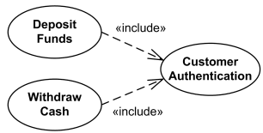
Use case “<<include>>” example

Slide 28
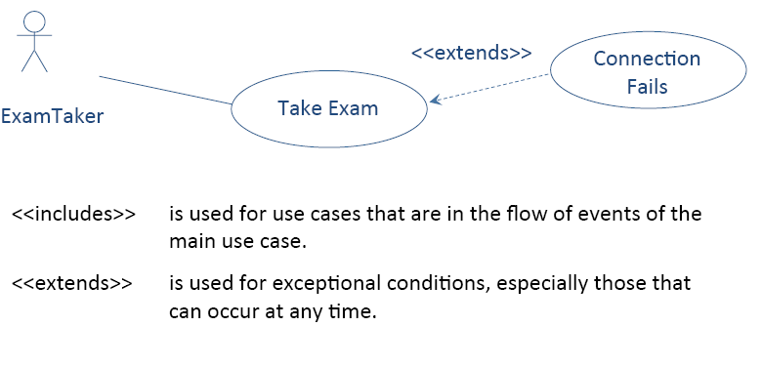
Relationship Between Use Cases <<extends>>

Slide 29
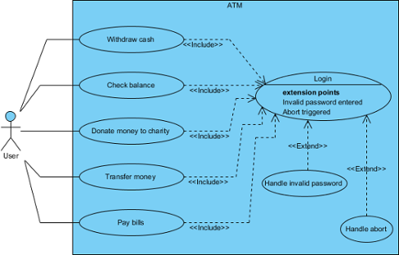
<<include>> and <<extend>>

Slide 31
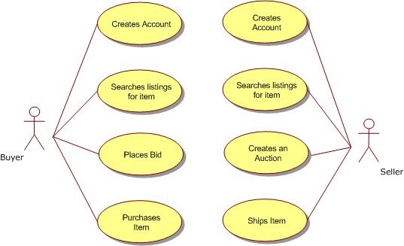
USE Case: Online Auction

Slide 32
Sequence Diagrams
Sequence diagrams are part of the UML and are used to model the interactions between the actors and the objects within a system.
A sequence diagram shows the sequence of interactions that take place during a particular use case.

Slide 33
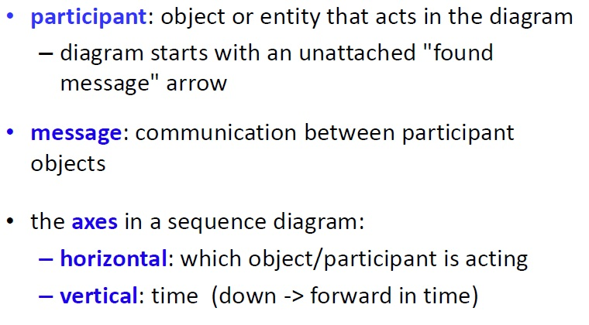
Sequence Diagram Key Parts

Slide 34
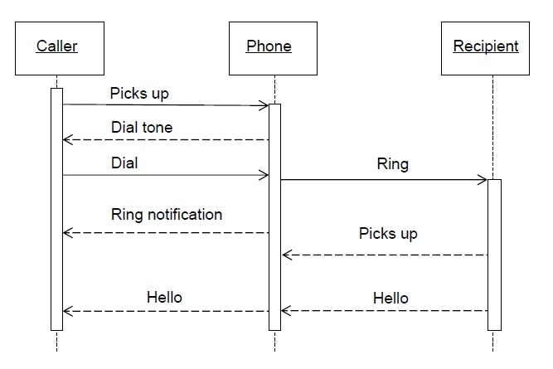
S.D (Make a Phone Call)

Slide 35
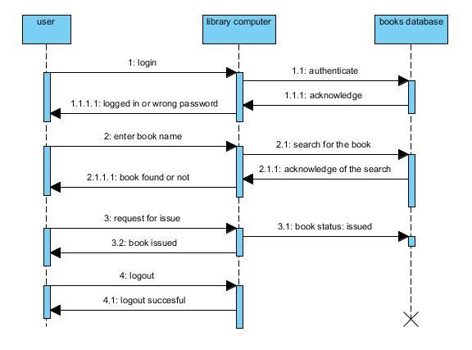

Slide 36
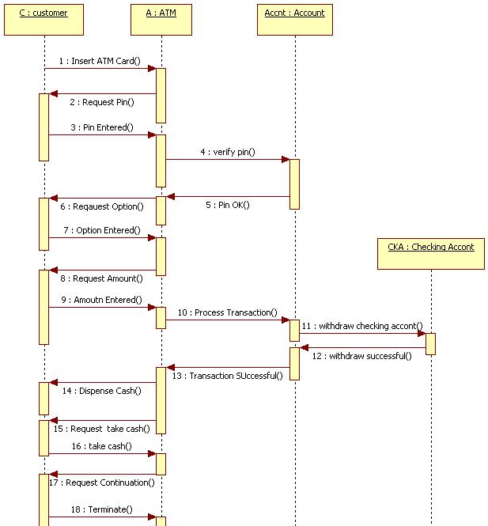
ATM Transaction

Slide 37
Sequence Diagram Tutorial
https://www.smartdraw.com/sequence-diagram/
https://www.youtube.com/watch?v=zLUOxlV2FGc

Slide 38
Structural models
Structural models of software display the organization of a system in terms of the components that make up that system and their relationships.
You create structural models of a system when you are discussing and designing the system architecture.

Slide 39
Class Diagram
Class diagram shows:
The system's classes
their attributes
operations (or methods)
and the relationships among objects.

Slide 40
Class diagram usability
In the design of a system, a number of classes are identified and grouped together in a class diagram that helps to determine the static relations between them.
With detailed modelling, the classes of the conceptual design are often split into a number of subclasses.

Slide 41
Class Visibility in UML
To specify the visibility of a class member (i.e. any attribute or method), these notations must be placed before the member's name
+ | Public
- | Private
# | Protected
/ | Derived (can be combined with one of the others)
~ | Package

Slide 42
Multiplicity
0 | No instances (rare)
0..1 | No instances, or one instance
1 | Exactly one instance
1..1 | Exactly one instance
0..* | Zero or more instances
* | Zero or more instances
1..* | One or more instances

Slide 43
UML Association
An association represents a family of links. An association can link any number of classes.
Types of association:
1. Binary: Link 2 classes
Aggregation
Composition
2. N-ary: Link N classes

Slide 44
Aggregation and Composition
A relationship between two objects is referred as an association
an association is known as composition when one object owns other(part-whole)
University and Departments
an association is known as aggregation when one object uses another object. (has-A)
Library and Students. Here the student can exist without library, the relation between student and library is aggregation.

Slide 45
Aggregation example
Pond
Duck
Office
Chair

Slide 46
Composition example
Person
Leg
Hand
Company
Department

Slide 47
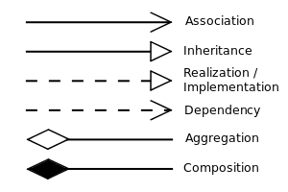
UML Relation Notations

Slide 48
UML classes and association
Show how many objects are involved in the association
That is, each patient has exactly one record and each record
maintains information about exactly one patient

Slide 49
UML classes and association
1
teaches
*
Teacher
Student
One- to-many
1
has
3
Tricycle
wheels
One -to -three
1
holds
12,24
Eggbox
Egg
One- to-12 or 24

Slide 50
Classes and associations in Bank
maintains
1
0..*
ATM transaction
Bank
1
1
ATM
performs
1
has
1…*
Customer
1
1…*
Account
Provide access to
Debit card
1
1

Slide 51
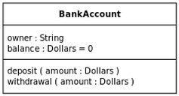
UML class examples with attributes and operations

Slide 52
Generalization
Generalization is an everyday technique that we use to manage complexity.
Rather than learn the detailed characteristics of every entity that we experience, we place these entities in more general classes (animals, cars, houses, etc.) and learn the characteristics of these classes.
This allows us to infer that different members of these classes have some common characteristics

Slide 53
Generalization
One class (the child class or subclass) can inherit attributes and operations from another (the parent class or superclass). The parent class is more general than the child class.
The lower-level classes are subclasses inherit the attributes and operations from their superclasses. These lower-level classes then add more specific attributes and operations.
The inheritance hierarchy doesn't have to end at two levels: A child class can be a parent class for still another child class.

Slide 54
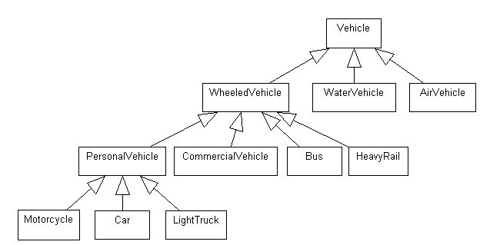
Generalization example
Attributes: Weight, passenger capacity, fuel tank capacity, colour, registration number, engine properties
Operation: startEngine(), stopEngine(), applyBrake(), accelerate()
Number of wheels
NumOfdoors
SwitchACON(),
SwitchACOFF()

Slide 55
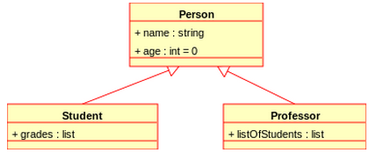
Generalization example

Slide 56
A generalization hierarchy with added detail

Slide 57
Library User class hierarchy

